Slide 1
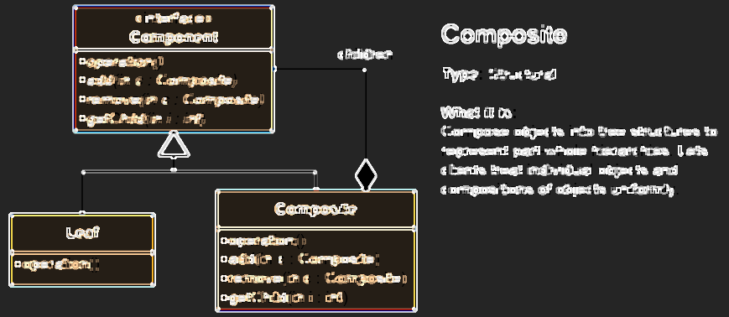
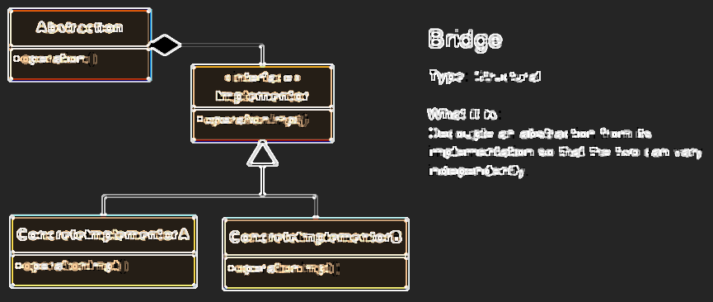
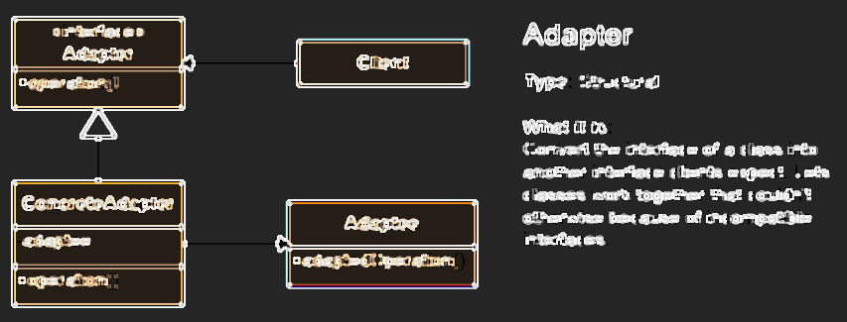
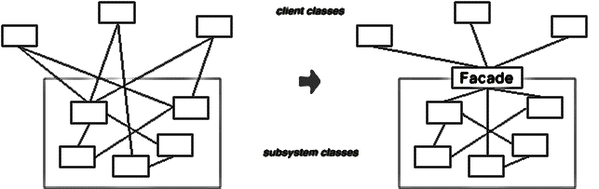
Structural Patterns
Describe ways to assemble objects to implement a new functionality
High-Quality Code
Telerik Software Academy
http://academy.telerik.com

Slide 2
Structural Patterns
Describe ways to assemble objects to implement a new functionality
Ease the design by identifying a simple way to realize relationships between entities
These design patterns are all about class and object composition
Structural class-creation patterns use inheritance to compose interfaces
Structural object-patterns define ways to compose objects to obtain new functionality

Slide 3
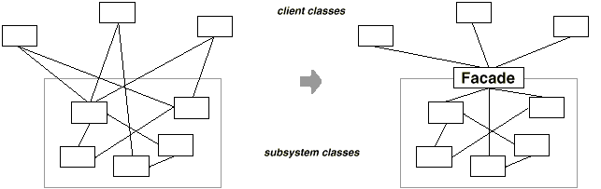
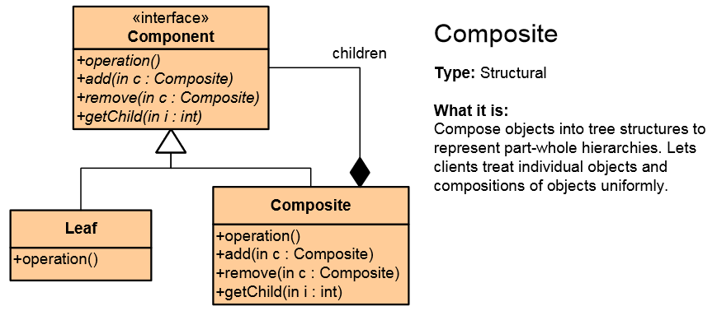
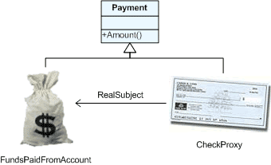
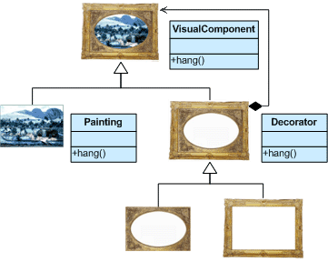
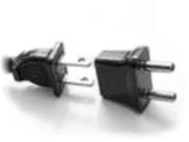
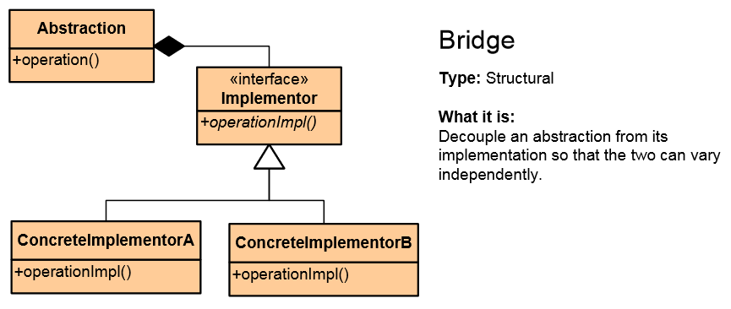
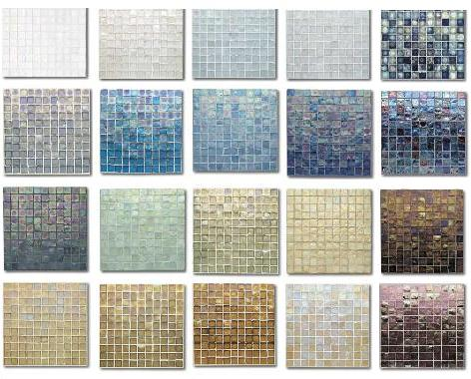
List of Structural Patterns
Façade
Composite
Flyweight
Proxy
Decorator
Adapter
Bridge

Slide 4

Façade

Slide 5

Facade Pattern
An object that provides a simplified interface to a larger body of code, such as class library
Make a software library easier to use, understand and more readable
Reduce dependencies of outside code
Keeps the Principle of least knowledge
Wrap a poorly designed APIs in a better one

Slide 6
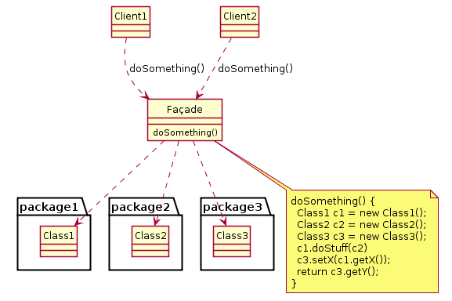
Facade Pattern Examples
Façade pattern used in many Win32 API based classes to hide Win32 complexity
In XmlSerializer (in .NET) and JSON serializer (in JSON.NET) hides a complex task (that includes generating assemblies on the fly!) behind a very easy-to-use class.
WebClient, File are another examples

Slide 7
Façade – Code Example
The hard way:
popper.On();
popper.Pop();
amp.On();
amp.SetSurroundSound();
amp.SetVolume(10);
amp.SetDvd(dvd);
screen.Down();
lights.Dimm(20);
projector.On();
projector.WideScreenMode();
dvd.On();
dvd.Play("Dzift");
The facade way:
homeTheater.WatchMovie("Dzift");

Slide 8
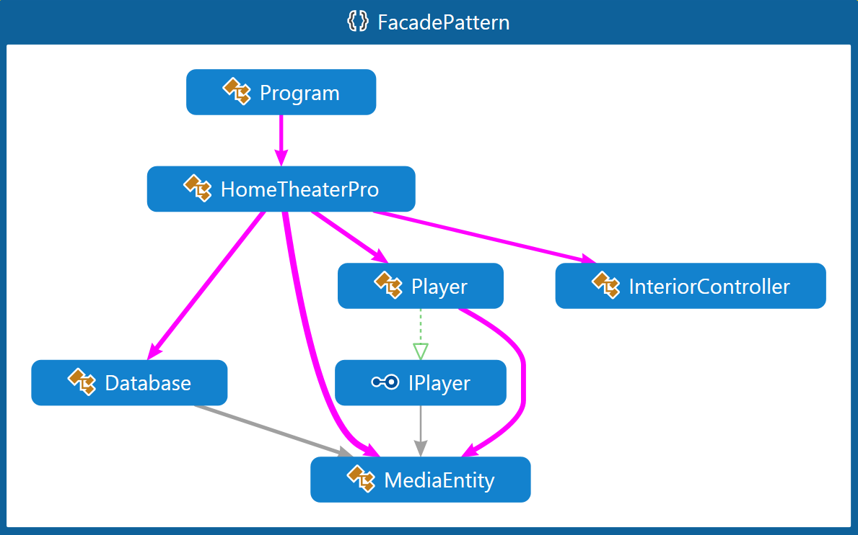
Façade – Demo

Slide 9

Composite

Slide 10
Composite Pattern
Composite Pattern allows to combine different types of objects in tree structures
Gives the possibility to treat the same individual objects or groups of objects

Slide 11
Composite Pattern (2)
Used when
We have different objects and we want to treat them the same way
We want to present hierarchy of objects
Tree-like structures
Examples in .NET Framework
Windows.Forms.Control and its derived classes
System.Web.UI.Control and its derived classes
System.Xml.XmlNode and its derived classes

Slide 12
Composite Pattern – Example
abstract class MailReceiver {
public abstract void SendMail();
}
class EmailAddress : MailReceiver {
public override void SendMail() { /*...*/ }
}
class GroupOfEmailAddresses : MailReceiver {
private List<MailReceiver> participants;
public override void SendMail() {
foreach(var p in participants) p.SendMail();
}
}
static void Main() {
var rootGroup = new GroupOfEmailAddresses();
rootGroup.SendMail();
}

Slide 13
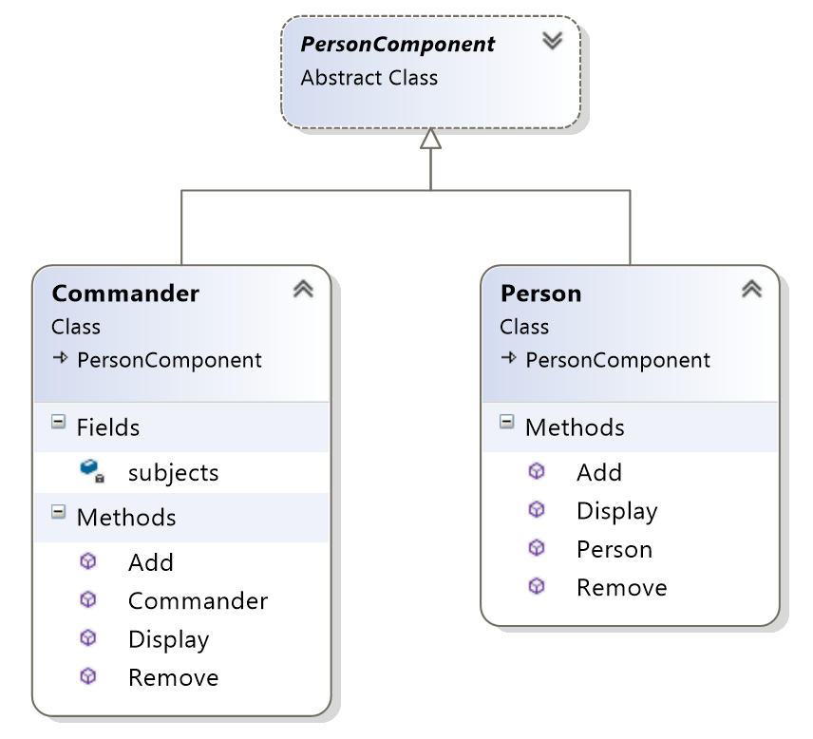
Composite Pattern – Demo

Slide 14

Flyweight

Slide 15
Flyweight Pattern
Use sharing to support large numbers of fine-grained objects efficiently
Reduce storage costs for large number of objects
Share objects to be used in multiple contexts simultaneously
Retain object oriented granularity and flexibility
Minimizes memory use by sharing as much data as possible with other similar objects
String.Intern returns Flyweight

Slide 16
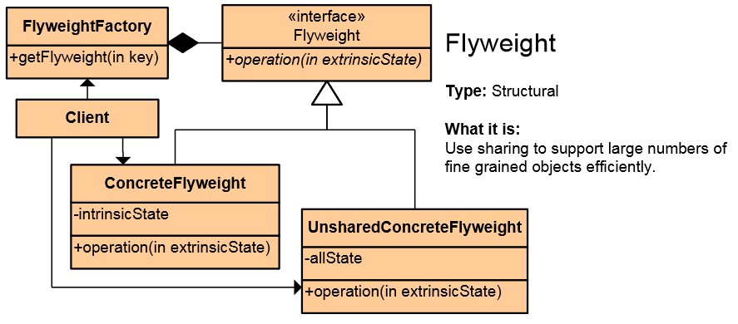
Flyweight Pattern
Each "flyweight" object is divided into 2 pieces:
state-dependent (extrinsic, as parameter)
state-independent (intrinsic, shared by factory)

Slide 17
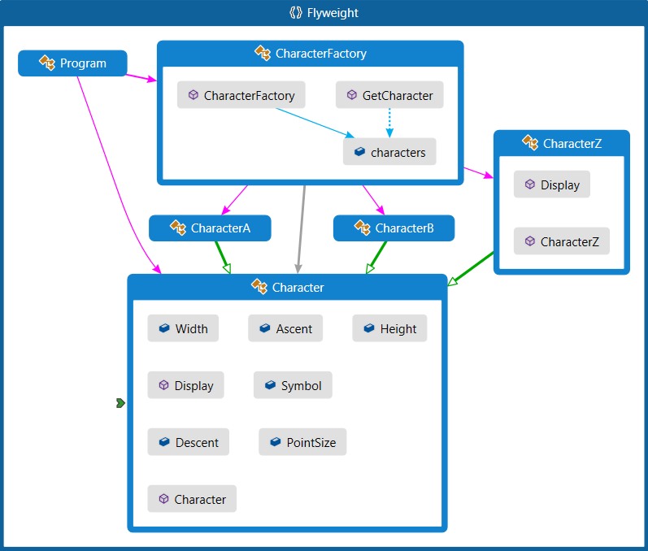
Flyweight – Demo

Slide 18
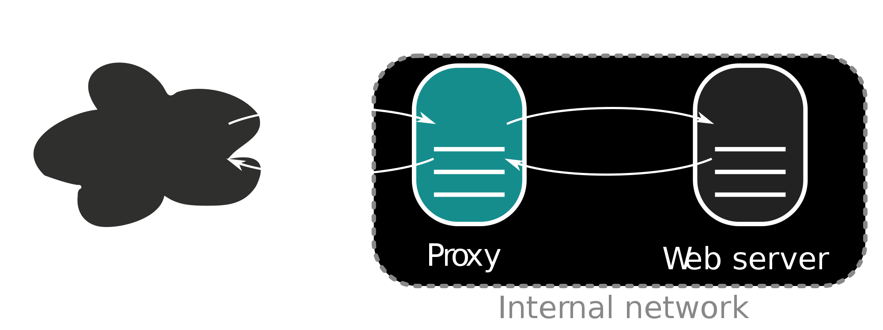
Proxy

Slide 19
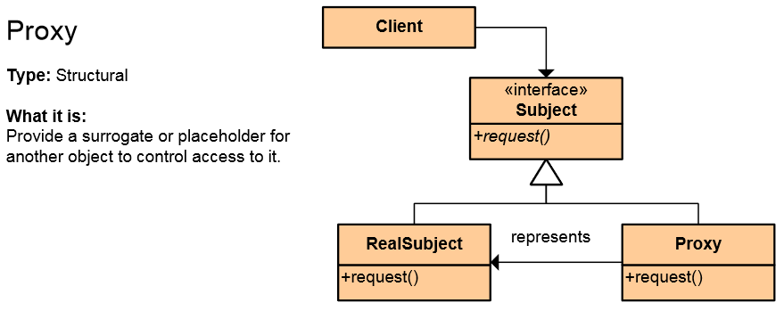
The Proxy Pattern
An object representing another object
Provide a surrogate or placeholder for another object to control access to it
Use an extra level of indirection to support distributed, controlled or intelligent access
Add a wrapper and delegation to protect the real component from undue complexity
Can be implemented using inheritance

Slide 20
Proxy – Applicability
Remote proxy
Local representative of remote object
Example: WPF (decouple networking details), COM Callable Wrappers
Virtual proxy
Creates expensive object on demand
Examples: placeholder image, Entity Framework, cached repository
Protection proxy
Used to control access to an object, based on some authorization rules

Slide 21
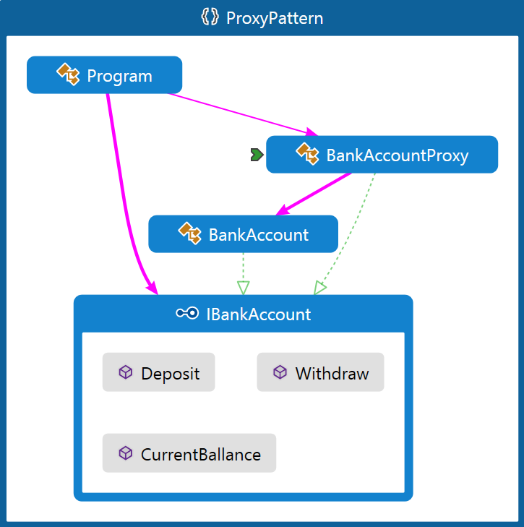
Proxy Pattern – Demo

Slide 22

Decorator

Slide 23
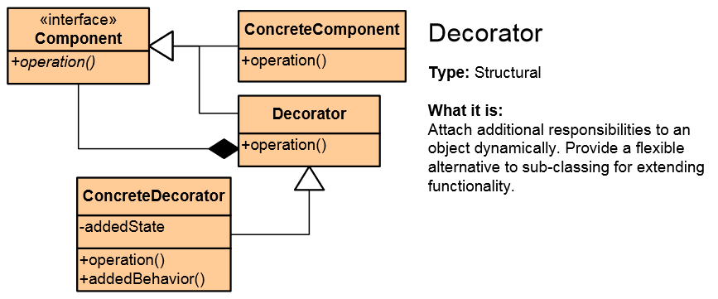
Decorator Pattern
Add functionality to existing objects at run-time
Wrapping original component
Alternative to inheritance (class explosion)
Support Open-Closed principle
Flexible design, original object is unaware

Slide 24
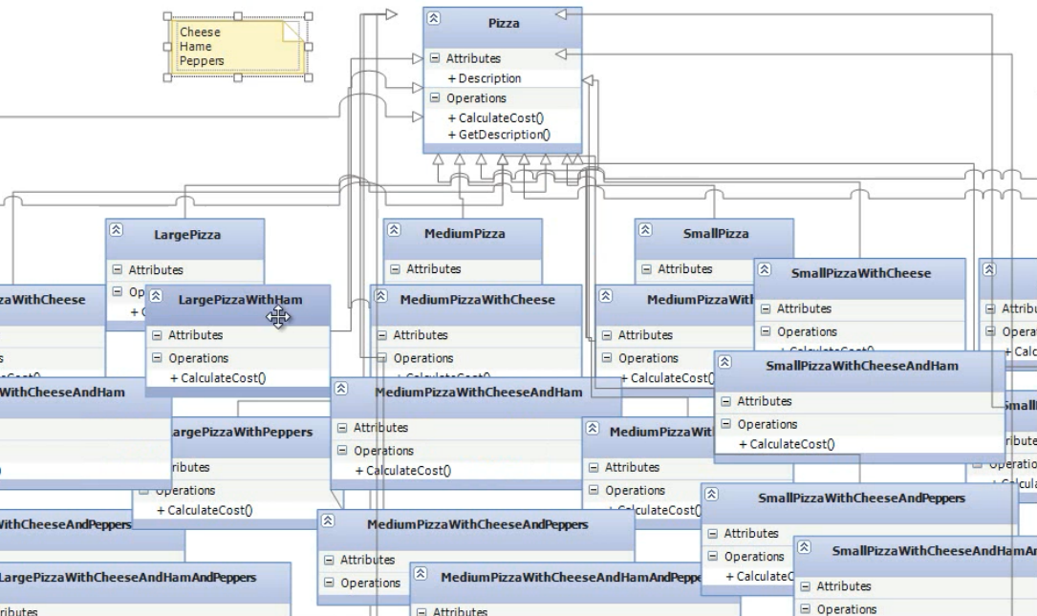
Class Explosion

Slide 25
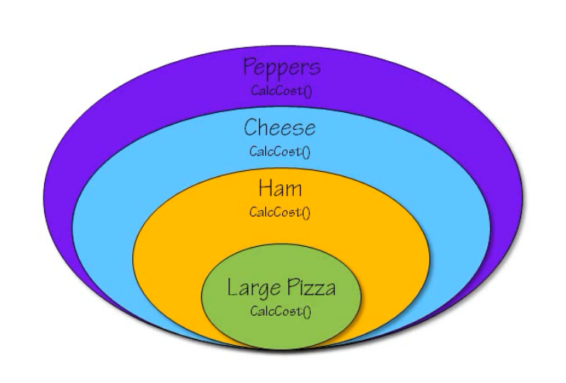
Preventing Class Еxplosion
LargePizzaWithCheeseHamAndPeppers
Create LargePizza, apply HamDecorator, apply CheeseDecorator and apply PeppersDecorator

Slide 26
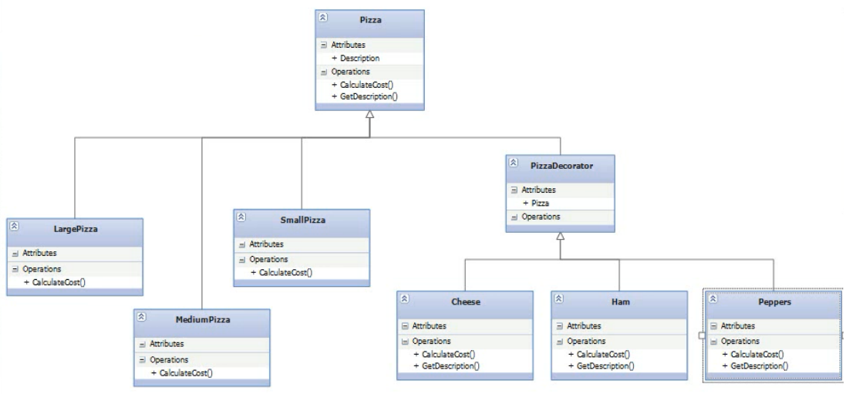
Class Explosion Refactored

Slide 27
Decorator Pattern Uses
Applicable in legacy systems
Used to add functionality to UI controls
Can be used to extend sealed classes
In .NET: CryptoStream and GZipStream decorates Stream
In WPF Decorator class provides a base class for elements that apply effects onto or around a single child element, such as Border or Viewbox

Slide 28
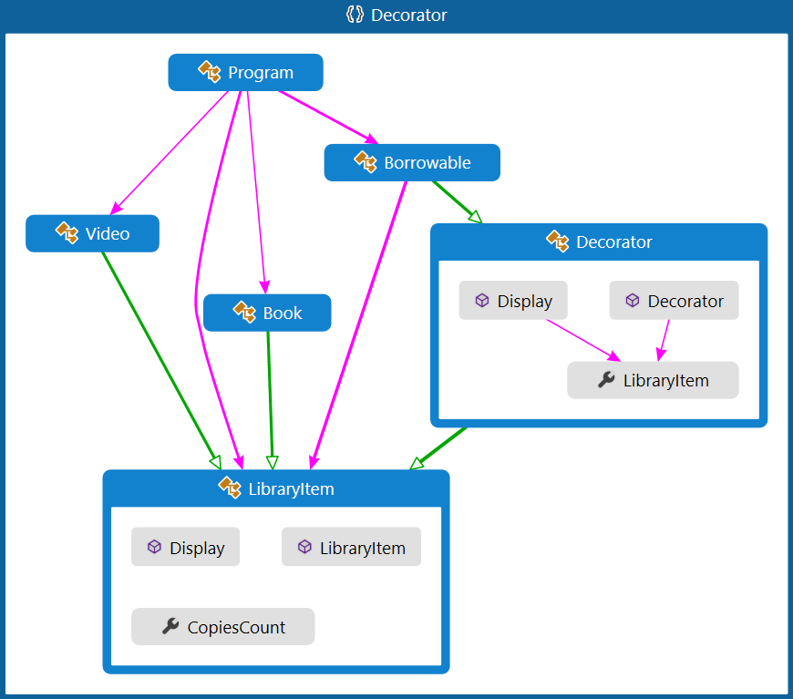
Decorator Pattern – Demo

Slide 29
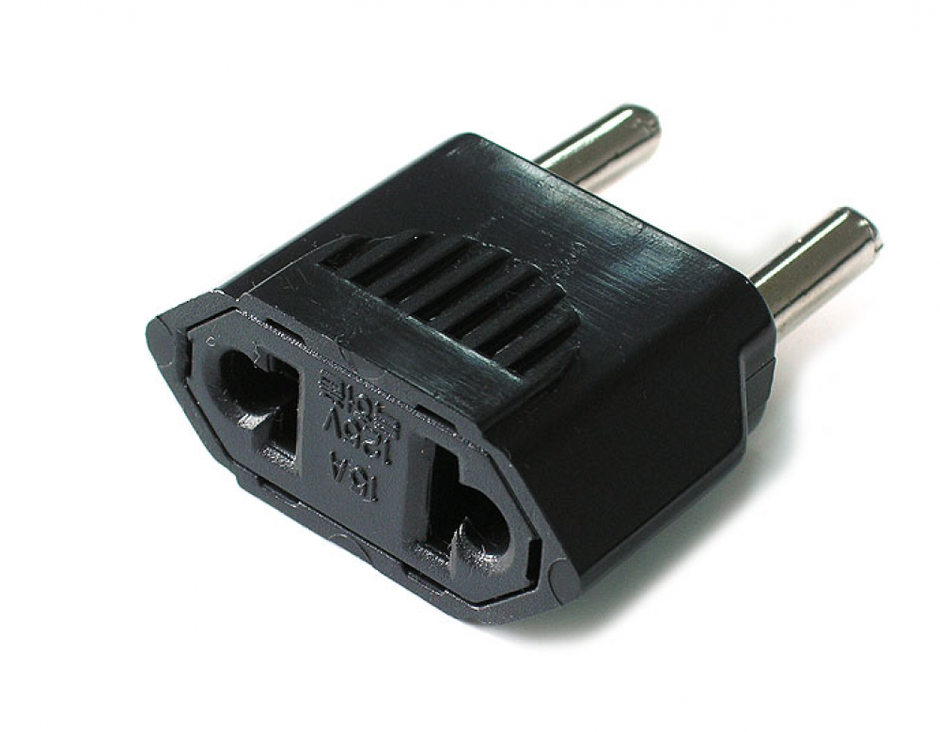
Adapter
a.k.a. Wrapper or Translator

Slide 30
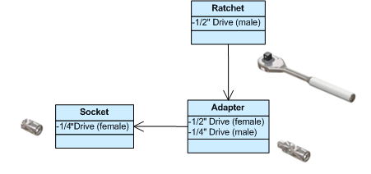
Adapter Pattern
Converts the given class' interface into another class requested by the client
Wraps an existing class with a new interface
Impedance match an old component to a new system
Allows classes to work together when this is impossible due to incompatible interfaces
In languages with multiple inheritance it is possible to adapt to more than one class (a.k.a. class adapters)

Slide 31
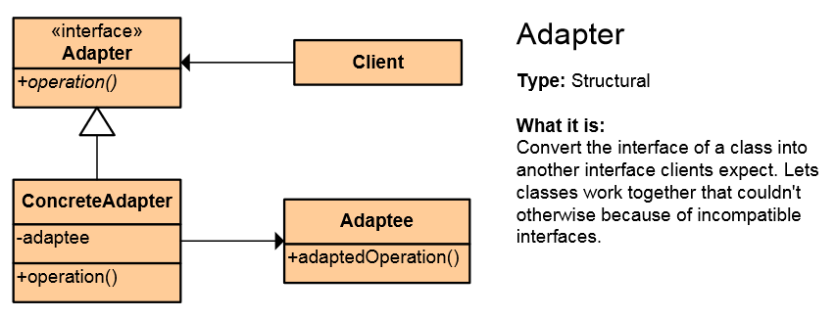
Adapter Pattern (2)
A single Adapter interface may work with many Adaptees
In ADO.NET we have IDataAdapter with OleDbDataAdapter, SqlClientDataAdapter
Each is an adapter for its specific database
Client wants to use the adaptee but can’t due to incompatible interfaces

Slide 32
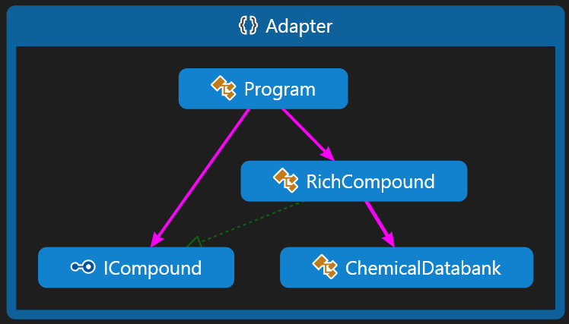
Adapter – Demo
In the demo, RichCompound implements ICompound and wraps ChemicalDatabank

Slide 33

Bridge

Slide 34

Bridge Pattern
Used to divide the abstraction and its implementation (they are by default coupled)
That way both can be rewritten independently
Solves problems usually solved by inheritance
From: Abstraction -> Implementation To: Abstraction -> Abstraction -> Implementation
One abstraction uses another abstraction and they can be changed independently

Slide 35
Bridge Pattern (2)
Abstraction and implementation can be extended independently
Creates “Has-A” relationship between Abstraction and Implementor
“Favor composition over inheritance”
Has-A

Slide 36
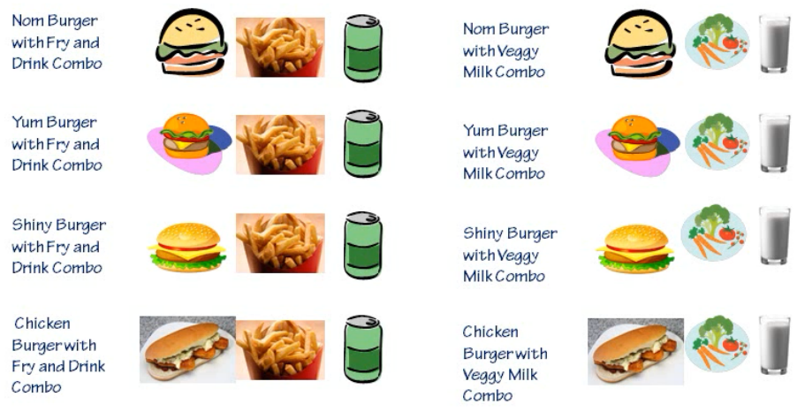
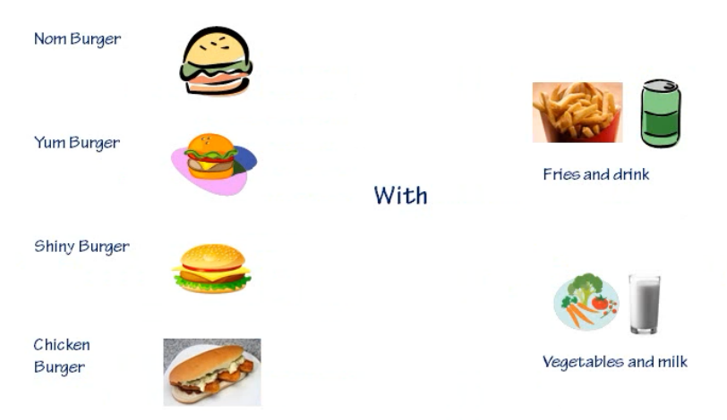
Bridge Example with Burgers
From coupled:
All menu combinations
To uncoupled:
Burger with addition
Two separate concepts
Bridge

Slide 37
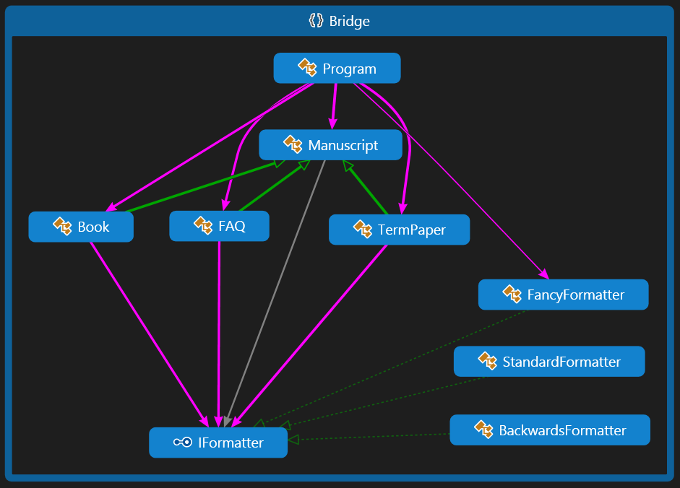
Bridge Pattern – Demo

Slide 38
Proxy vs. Decorator vs. Adapter vs. Bridge
Proxy – to lazy-instantiate an object, or hide the fact that you're calling a remote service, or control access to the object (one-to-one interface)
Decorator – to add functionality to an object runtime (not by extending that object's type)
Adapter – to map an abstract interface to another object which has similar functional role, but a different interface (changes interface for the client)
Bridge – define both the abstract interface and the underlying implementation. I.e. you're not adapting to some legacy or third-party code, you're the designer of all the code but you need to be able to swap out different implementations (all changeable)

Slide 39
Structural Patterns
http://academy.telerik.com

Slide 40




Free Trainings @ Telerik Academy
C# Programming @ Telerik Academy
csharpfundamentals.telerik.com
Telerik Software Academy
academy.telerik.com
Telerik Academy @ Facebook
facebook.com/TelerikAcademy
Telerik Software Academy Forums
forums.academy.telerik.com

